Slide 1





Creating Scientific Graphs with Python and AI
Lachlan McKinnie, Alumni,
University of the Sunshine Coast
Lachlan.McKinnie@research.usc.edu.au

Slide 2
Who am I?
Introduction
PhD graduate from the University of the Sunshine Coast
Researched algal genetics, with a focus on biosynthetic pathways
My research was entirely bioinformatics based
Main coding skills in Python, as well as web design with HTML, CSS and a little bit of JavaScript
Big fan of getting ChatGPT to code new things for me

Slide 3
Session plan
Introduction
Overview
Software installation: Download Python IDE, access ChatGPT
Introduction: What is Python? What can it be used for?
Basic introduction to Python coding with ChatGPT
How to generate graphs using Python code generated by ChatGPT
Performing statistical tests with ChatGPT and Python
Altering and sharing ChatGPT scripts
Further applications

Slide 4
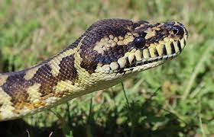
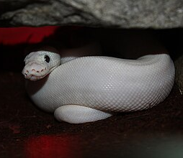
Python
Introduction
Pythons are non-venomous constricting snakes from the family Pythonidae
Cute danger noodles. Much fren.
Very boopable snoots*
Pythons don’t make for good coders, but they can be good cuddle buddies
*Please do not boop the snoots of wild danger noodles

Slide 5
AI: To Use or Not to Use
Introduction
Pros
Cons
Can immensely speed up work
Can produce code that you are not familiar with
Good sounding board for ideas
Can inhibit learning if you rely on AI
Data may be kept for training their engine – NOT SECURE
Not accurate when relying on factual accuracy
Can be a Yes-man – can agree with you even if you are wrong

Slide 6
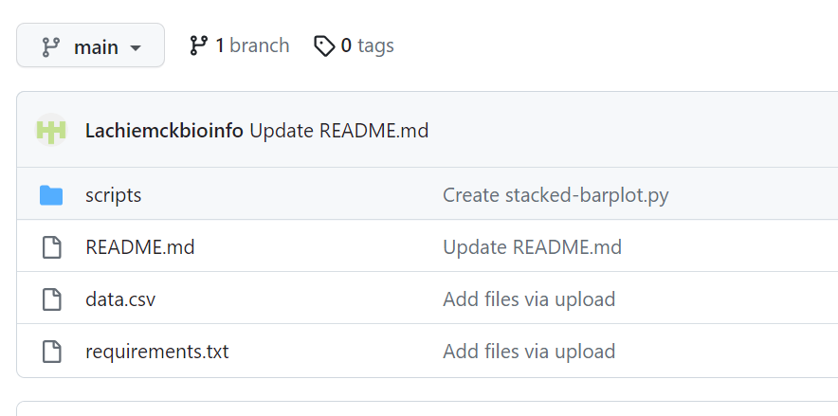
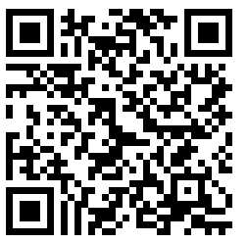
Data We Will Be Using
Introduction
We will be analysing data from an Excel spreadsheet in csv format
Download from GitHub: https://github.com/Lachiemckbioinfo/ResBaz2025-dataset
Click on file data.csv, and select download raw
Save it to where your Python scripts will be saved
Feel free to use your own data instead if you want!

Slide 7
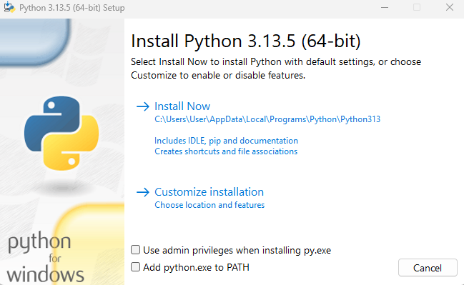
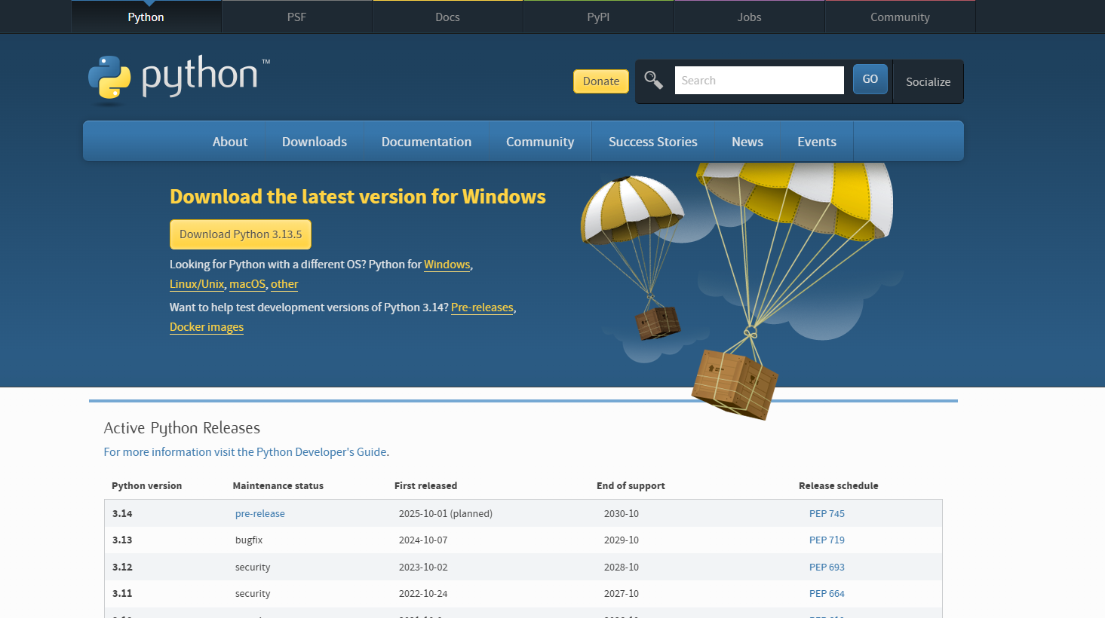
Installing Python
Introduction
Download free from Python website
www.python.org/downloads/

Slide 8

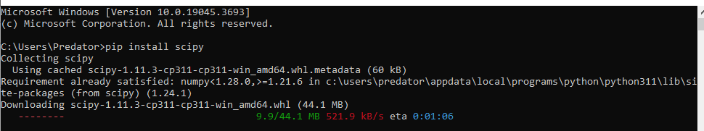
Python Libraries
Introduction
Essential libraries:
numpy: Maths and number manipulation
pandas: Controls
matplotlib: Graphing
Optional libraries
Seaborn (more graphing options, colours)
Installation: go to command prompt/terminal
pip install <library>
Can chain multiple together at once

Slide 9
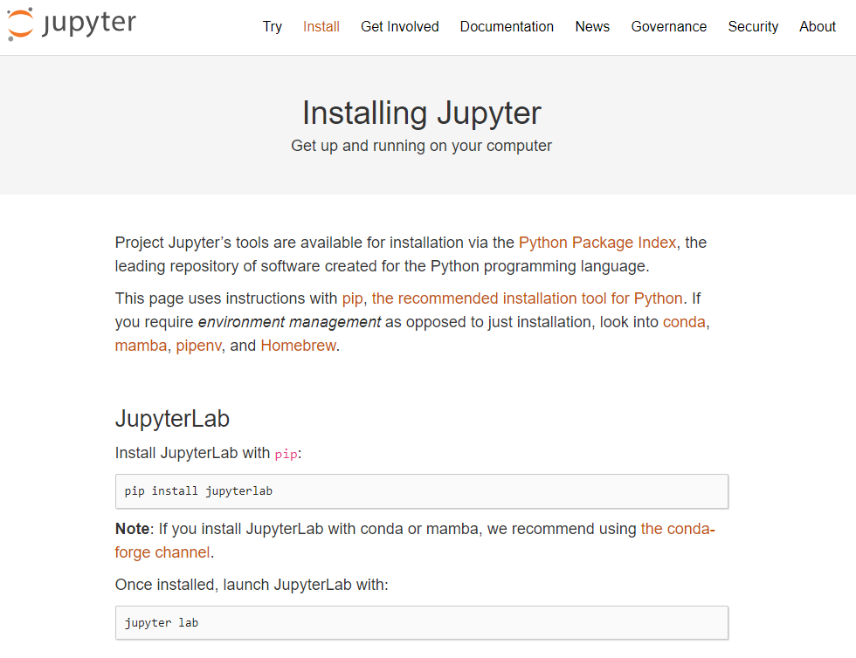
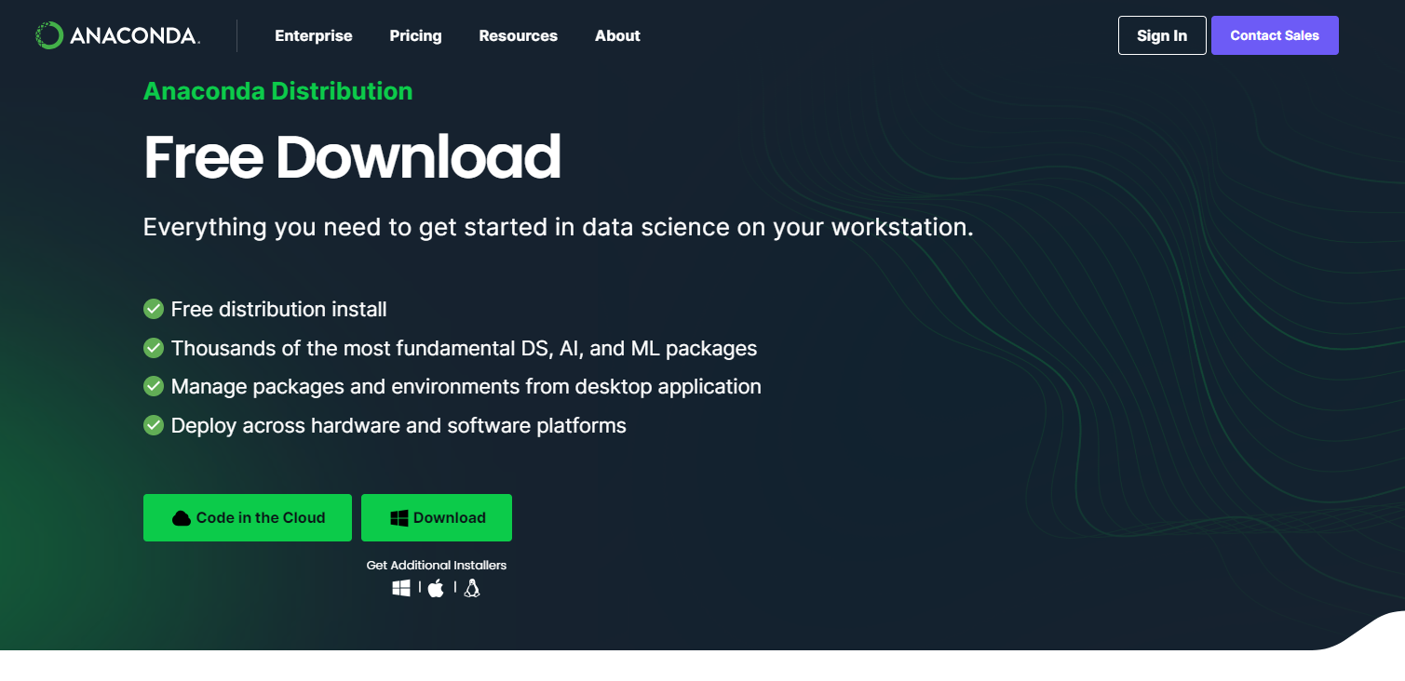
IDEs (Integrated Development Environment)
Introduction
Anaconda
https://www.anaconda.com/download
Includes Python
Jupyter Lab
https://jupyter.org/install
Requires Python

Slide 10
Generative AI
Introduction
Various options available to use
CoPilot, ChatGPT, Claude, Grok
ChatGPT free to use, requires account
CoPilot access via university
If you don’t want to make accounts, I have scripts that can be downloaded

Slide 11
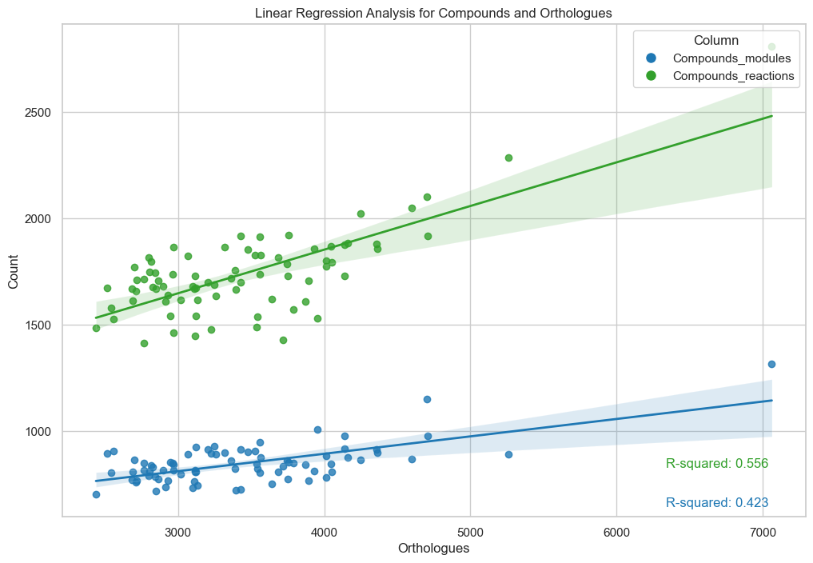
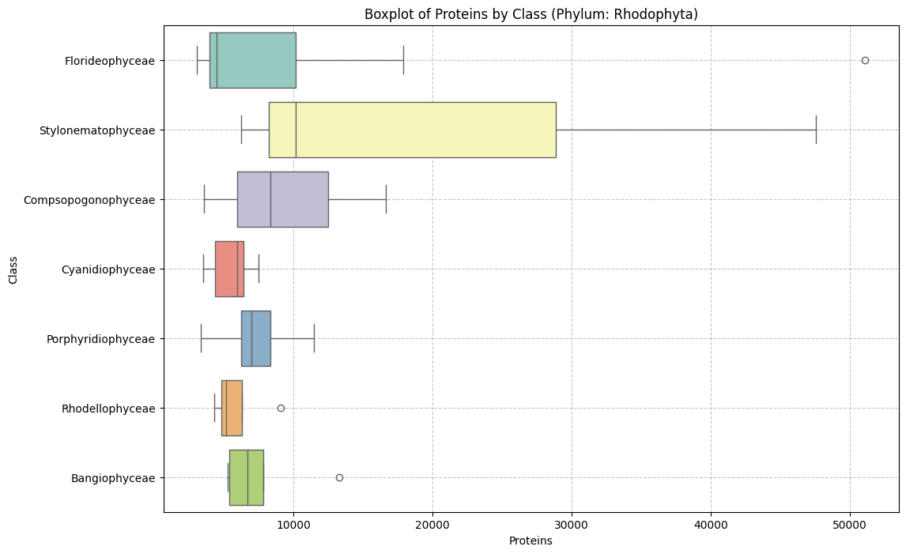
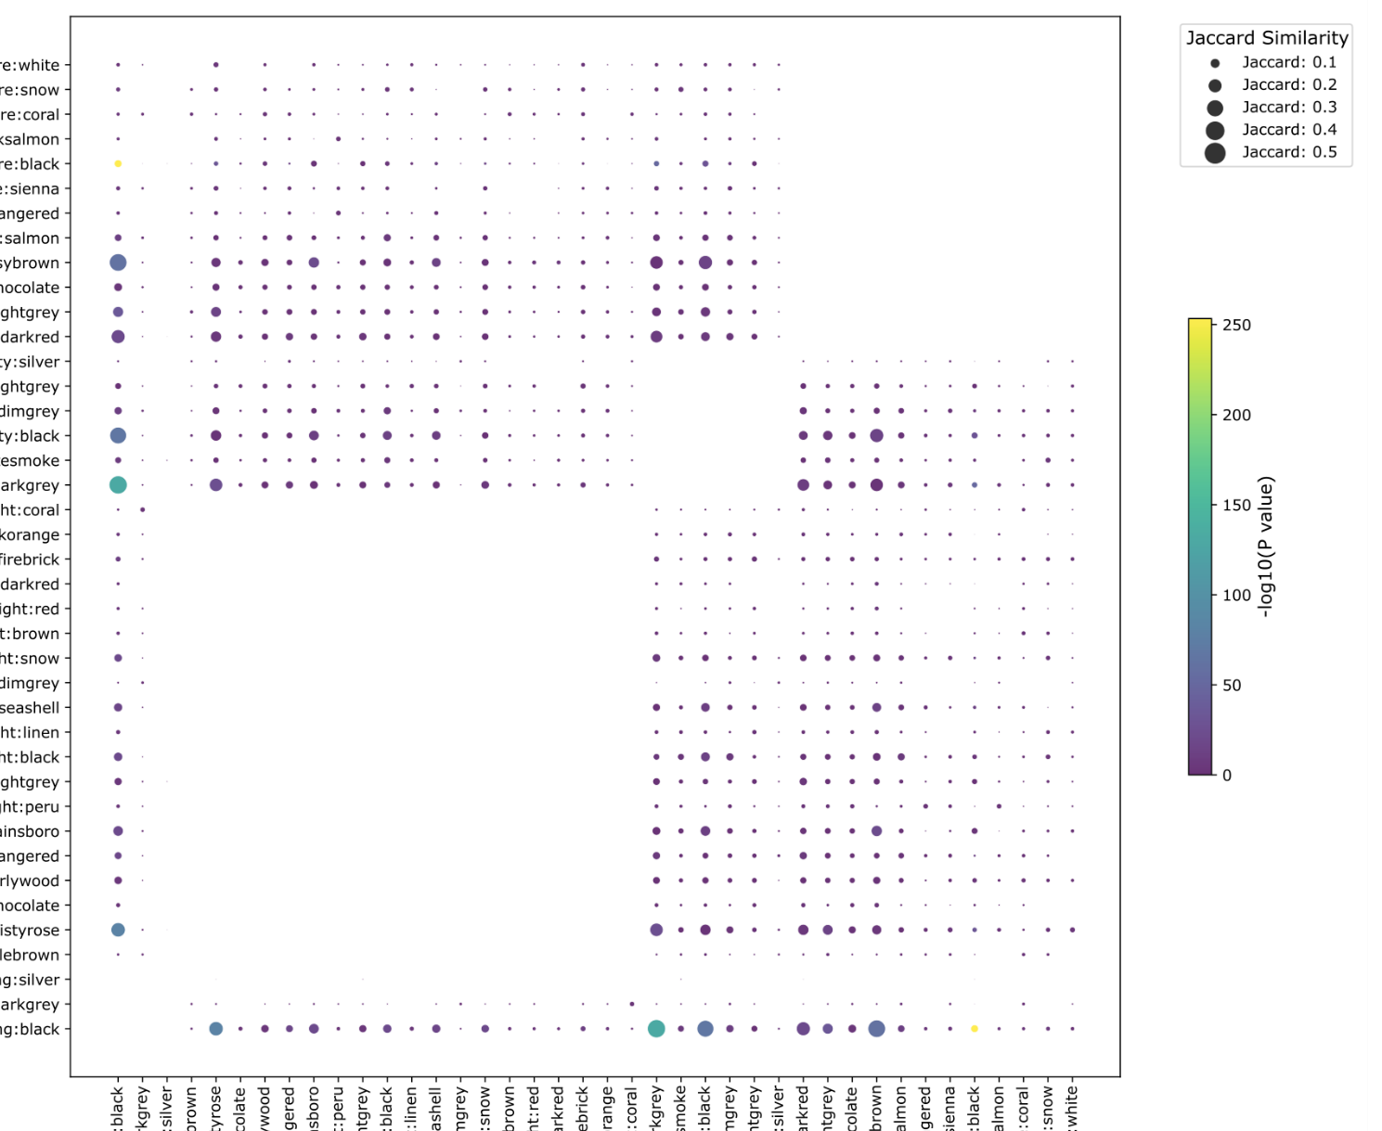
Plot examples
Introduction

Slide 12
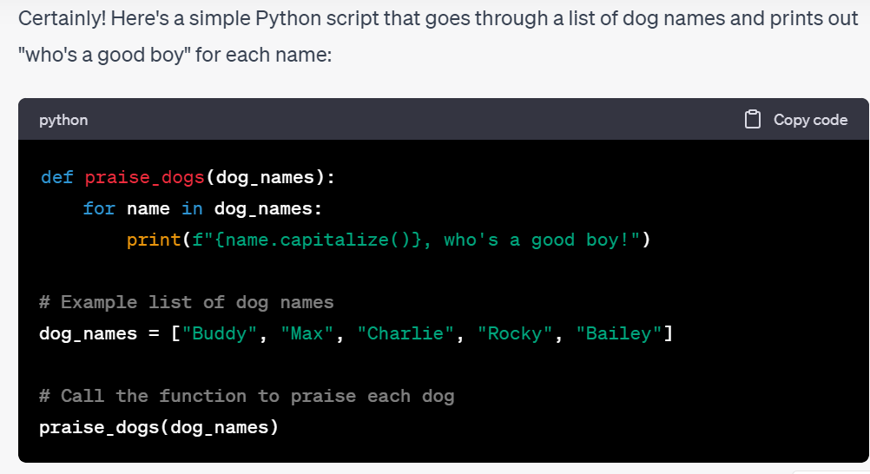
Task 1: Generating basic Python Script
Task 1
Log into ChatGPT and open up your Python environment
Ask ChatGPT to generate a simple Python script. For example:
Code a Python script to go through a list of dog names and say “who’s a good boy” name.

Slide 13
Task 1: Generating basic Python Script
Task 1
Review: how many different approaches did ChatGPT use to make this function?
Did it show you any new Python techniques?

Slide 14
Analysing data from a dataset
Task 2
We will be analysing data from an Excel spreadsheet in csv format
Email attachment
Download from GitHub

Slide 15
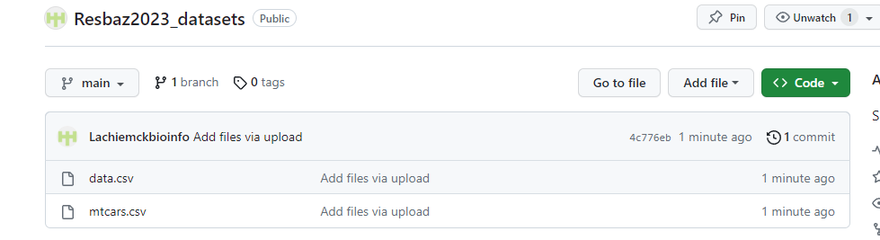
Analysing data from a dataset
Task 2
We will be analysing data from an Excel spreadsheet in csv format
Download from GitHub: https://github.com/Lachiemckbioinfo/Resbaz2023_datasets
Click on file data.csv, and

Slide 16
Analysing data from a dataset
Task 2
We will be making the following plots: bar graph, stacked bar graph, boxplot, and scatterplot
Use the data.csv file.

Slide 17
Bar graphs
Task 2a
Lets start with a simple bargraph.
Try the following question:
I have a csv file called data.csv that has both numeric and categorical data. In it, the column Seqtype shows whether a given item is a genome or transcriptome. Make a Python script using Pandas and Matplotlib to create a bar graph showing the numbers of genomes and transcriptomes

Slide 18
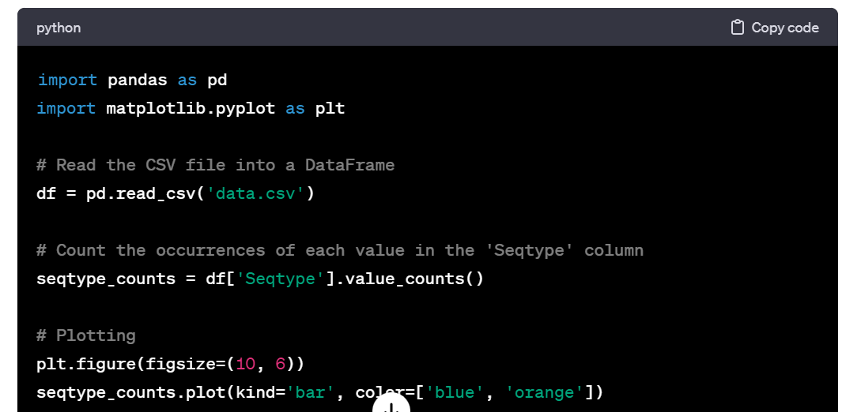
Bar graphs
Task 2a
Click Copy code
Paste into your Python environment

Slide 19
Bar graphs: improving results
Task 2a
Try editing the output with the following prompts:
Change the data input to the Scale column, which uses the categories Microalgae and Macroalgae
Change the graph so that it would be suitable for a scientific publication

Slide 20
Stacked Bar graphs
Task 2b
We can also do more advanced bar plots. Try:
Make a stacked bar graph using the Seqtype column, which has categorical values, with subcategories from the Class column
Improve: ask ChatGPT to make the plot wider, and make sure the legend does not overlap the plot itself.
Advanced: we are mainly looking for red algae (phylum Rhodophyta), however there are some green algae in this dataset. Ask ChatGPT to filter out items which do not belong to phylum Rhodophyta.

Slide 21
Scatterplots
Task 2b
For two sets of numerial data, we can do scatterplots.
Lets try the following: generate a Python script to make a scatterplot using the columns Proteins and Compounds
Advanced: try adding linear regression, or colour by category
You may need to specify to use only matplotlib, pandas and numpy. ChatGPT may code in other libraries, like seaborn or scipy. Seaborn adds more colours, while scipy does more advanced statistical analysis.

Slide 22
Scatterplots
Task 2c
Review: What new techniques did you learn from this?
See if you can make it look like a proper scientific graph

Slide 23
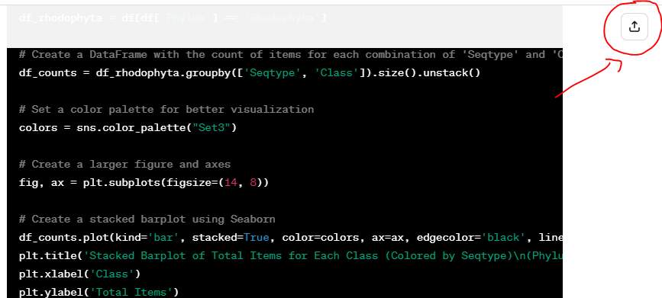
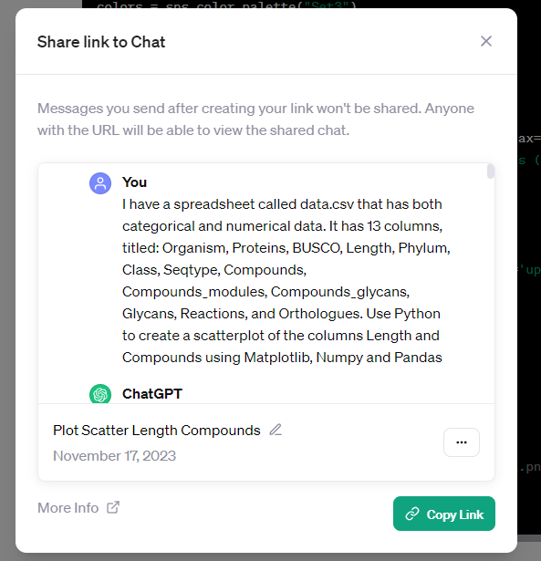
Sharing ChatGPT chats
Sharing chats
Sometimes it is useful to share the chat you have with ChatGPT
Clicking the Share button will create a link to your chat that you can share

Slide 24

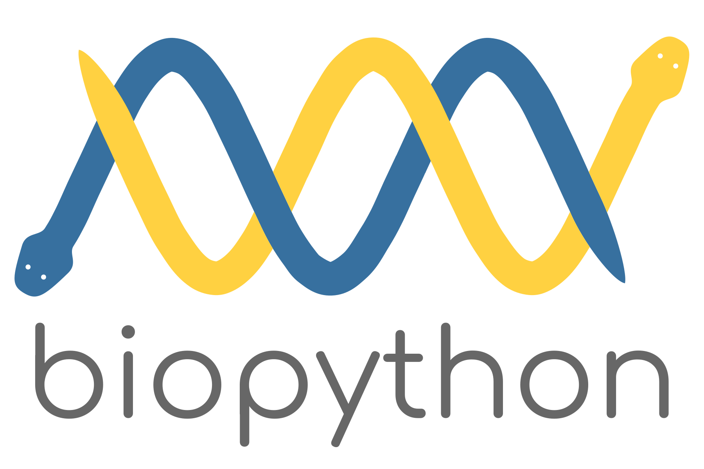

Further applications in Python programming
Conclusions
Web design with Flask, Django, or FastAPI
Bioinformatics analysis with BioPython
Game design with Pygame

Slide 25
Learning Resources
Conclusions
Web3Schools: https://www.w3schools.com/
Data Carpentry: https://datacarpentry.org/lessons/
StackOverFlow: https://stackoverflow.com/questions
Khan Academy: https://www.khanacademy.org/

